Slide 1
Text Mining Project on Toyota Dealership Survey
Phase 2 HT Classification Results Delivery

Slide 2
Methodology - CNN
Pre-Processing
Extract data (HT experience and labels) from CSV form.
Map label to integer, then represent using categorical one-hot encoding.
HT experience sentences cleaning, pre-processing, tokenizing, then pad sentences into same length using special padding character (<PAD/>).
Word Embedding
Use pre-trained word embedding ‘Word2Vec’ to represent each word (300 dimension).
Give zero embedding to special padding character (<PAD/>) and a random initialized vector to represent all the unknown words.

Slide 3
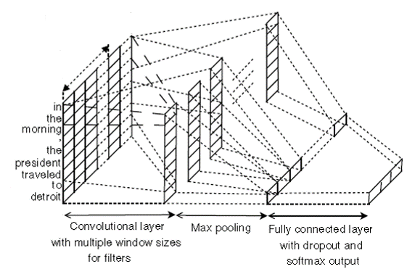
Methodology - CNN
CNN Architecture
word embedding

Slide 4
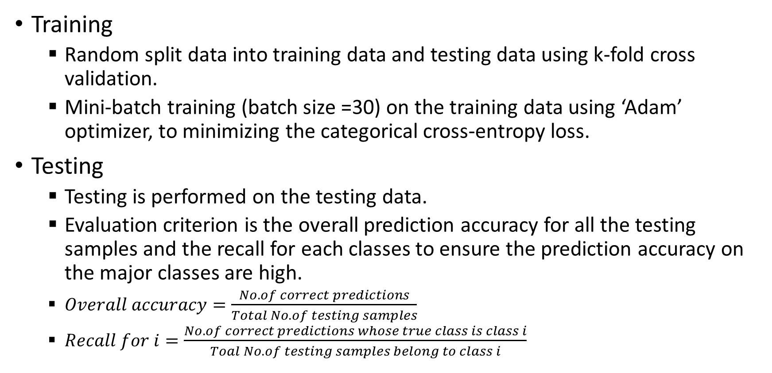
Methodology - CNN
Training
Random split data into training data and testing data using k-fold cross validation.
Mini-batch training (batch size =30) on the training data using ‘Adam’ optimizer, to minimizing the categorical cross-entropy loss.
Testing
Testing is performed on the testing data.
Evaluation criterion is the overall prediction accuracy for all the testing samples and the recall for each classes to ensure the prediction accuracy on the major classes are high.
$Overall accuracy=\frac{No. of correct predictions}{Total No. of testing samples}$
$Recall for i=\frac{No. of correct predictions whose true class is class i}{Toal No. of testing samples belong to class i}$

Slide 5
“Context” Category
Class Label Distribution
Classification Results (Top-1 Accuracy)
Overall accuracy: 80.4%
Accuracy for 'Ordinary Situation': 85%
Accuracy for 'Problem': 86%
Accuracy for 'Emergency': 16%
Accuracy for 'Special Occasion': 38%
Label | Ordinary Situation | Problem | Emergency | Special Occasion
Count | 2615 | 2440 | 284 | 237
Freq | 46.90% | 43.76% | 5.09% | 4.25%

Slide 6
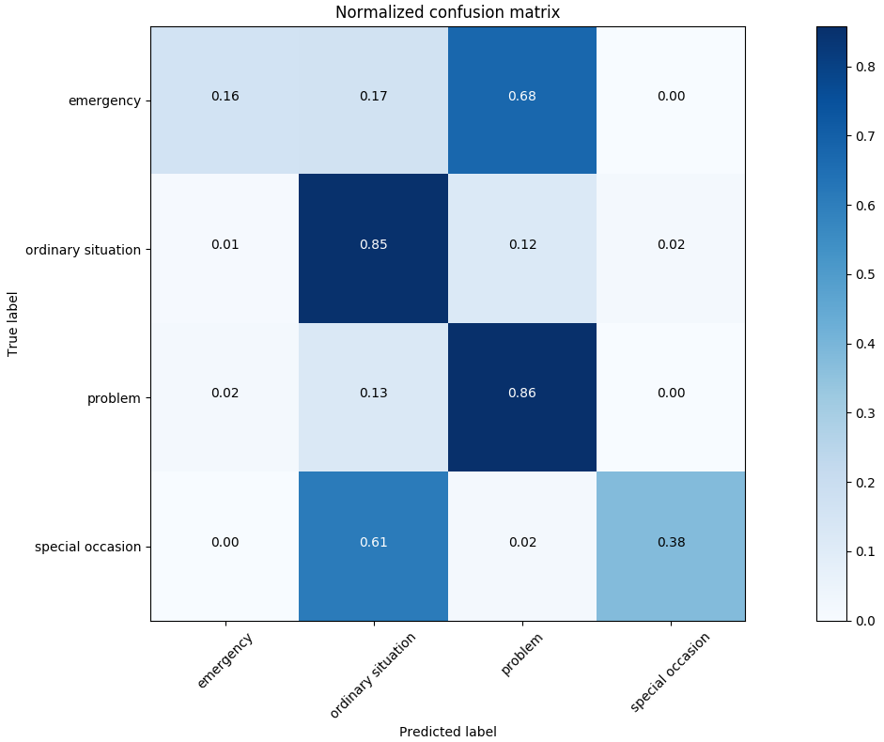
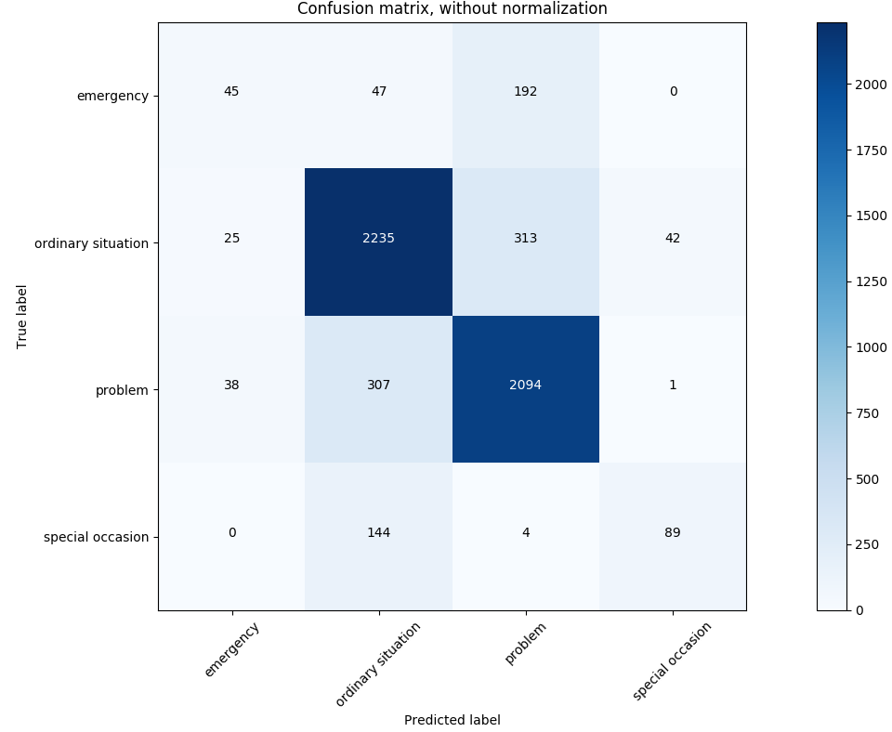
“Context” Category
Confusion Matrix
Label:
{u'emergency': 0 , u'ordinary situation': 1, u'problem': 2, u'special occasion': 3,}

Slide 7
“Context” Category
Result Analysis
Ordinary Situation and Problem:
According to the confusion matrix, classification accuracy for major categories (ordinary situation and problem) are quite good.
Emergency:
The classification results are not satisfactory because we found that a large number of sentences with ‘Emergency’ are labeled to belong to the major categories. In particular, we found at least 30 sentences and 20 sentences that should be in ‘Emergency’ category are mislabeled to the ‘Problem’ and ‘Ordinary Situation’ categories, respectively. That’s why a large number of samples are wrongly predicted to be ‘Problem’ and ‘Ordinary Situation’.
Special Occasion:
By looking into the labeling of ‘Special Occasion’ and ‘Ordinary Situation’, we found that there are many overlapping samples between these two categories. Due to the inconsistency and overlapping labelling of ‘Ordinary Situation’ and ‘Special Occasion’, our CNN model cannot distinguish between these two categories.

Slide 8
“Context” Category
Summary and Suggestion
We found many labelling errors as well as inconsistent/overlapping labels of training data.
In order to make better prediction for any machine learning model, the quality of training data plays a vital role.
Our suggestion is to re-label the training data according to our analysis in section 1.3 of the attached result analysis, to make the samples in one class distinguishable from other classes.

Slide 9
“Content” Category
Class Label Distribution
Label | Roadside Assistance | Personal Need | Issue Resolution | Quick Service | Gift / Free Stuff | Pick up / Drop | Detailed Explanation
Count | 1231 | 1118 | 833 | 707 | 497 | 335 | 227
Freq | 22.08% | 20.05% | 14.94% | 12.68% | 8.91% | 6.01% | 4.07%
Label | Care from Staff | Snacks | Free Service / Discount | Others | Forgotten Stuff | dealer event
Count | 187 | 161 | 111 | 73 | 58 | 38
Freq | 3.35% | 2.89% | 1.99% | 1.31% | 1.04% | 0.68%
Classification Results (Top-1 Accuracy)
Overall accuracy: 60.58%
Accuracy for 'roadside assistance': 82%
Accuracy for 'personal need': 60%
Accuracy for 'issue resolution': 53%
Accuracy for 'quick service': 51%
Accuracy for 'gift / free stuff': 79%
Accuracy for 'pick up / drop': 53%
Accuracy for 'detailed explanation': 43%
Accuracy for 'care from staff': 26%
Accuracy for 'snacks': 70%
Accuracy for 'free service / discount': 41%
Accuracy for 'others': 1%
Accuracy for 'forgotten stuff': 48%
Accuracy for 'dealer event': 43%

Slide 10
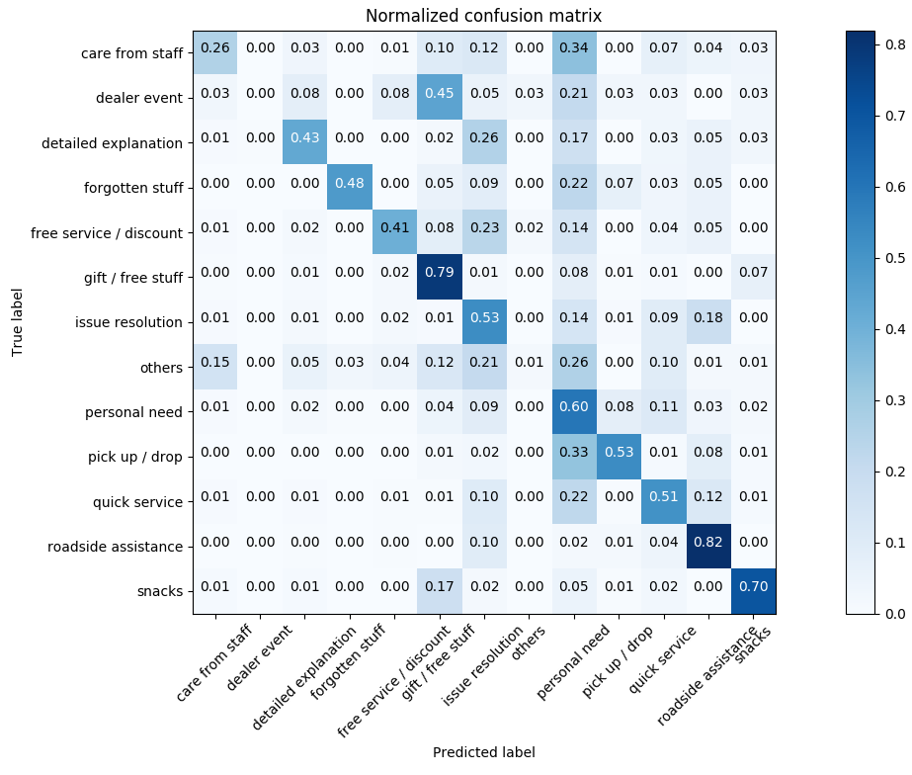
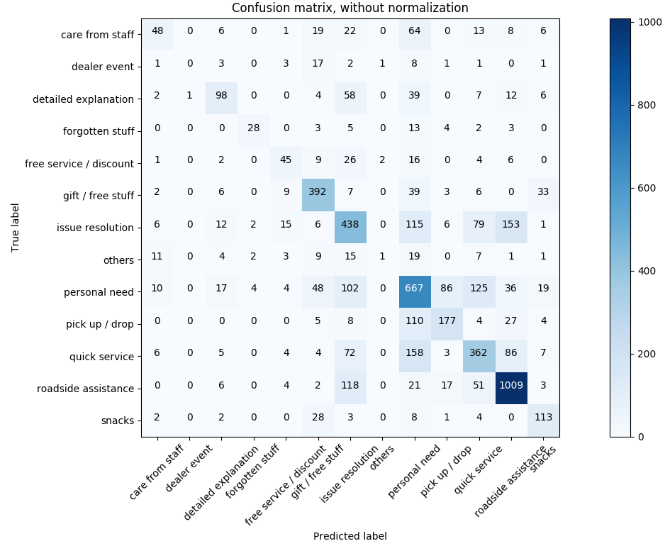
“Content” Category
Confusion Matrix
Label:
{u'care from staff': 0, u'dealer event': 1, u'detailed explanation': 2, u'forgotten stuff': 3 , u'free service / discount': 4, u'gift / free stuff': 5, u'issue resolution': 6, u'others': 7, u'personal need': 8, u'pick up / drop': 9, u'quick service': 10, u'roadside assistance': 11, u'snacks': 12,}

Slide 11
“Content” Category
Selected Result Analysis
Care from staff:
The predictions of “care” are highly confused with the categories of “personal need”. In addition, this category is somehow confused with the category “issue resolution”.
Dealer Event:
The performance is really poor and most of the sentences are predicted to the category of “gift/free stuff”. The reason can be explained by the fact that gifts or free stuffs are always associated the dealer event or promotion occasions.
Free Service/ Discount:
The most confusing category with respect to this category is “issue resolution”. The reason is that most of the mislabeled data are associated with issue resolution at lower or free cost.
Personal Need:
The confusing categories of it are “issue resolution”, “pickup/drop”, and “quick service”. This is either the issue of incorrect labeling of “personal need” or merge the concept of “issue resolution” into more detailed categories such as “personal need”. The labels are also poorly annotated into “pickup/drop” because these mislabeling cases contain the keyword pickup, drop.
Quick Service:
We find that some mislabeled comments include keyword appointment that fulfils the definition of “personal need”.

Slide 12
“Content” Category
Summary and Suggestion
In conclusion, we find many labelling errors (labeled into wrong category) in terms of the definition of categories offered in Exercise_Classification of HT cases_Definitions+Analysis template_Feedback.xlsx.
Besides, we also find some comments involving multiple labels such as “Once I called up the road side assistance because I caught an accident. The technician came promptly and delivered my car in dealership within one hour.” It can be labeled into either “roadside assistance” or “quick service”. Our suggestion is that you can either standardize the labels to unique labels or keep the two labels (multi-labeling).
To our knowledge, the major problematic categories are two large sets that are elaborated in issue resolution and personal need. The labels require much more careful check to improve the overall performance.

